Slide 1

Dangerous Roads Prediction

Slide 2

Index
Abstract
Introduction
Requirements
Classifiers
Sample dataset
Results
Conclusion

Slide 3
Abstract
Our country, India, unfortunately ranks at the top with highest number of fatalities with about 11% share in the world, in which Andhra Pradesh continues its rank with 7th position in India since 2015.The “Dangerous Roads Prediction” is an effort to highlight the District-wise data and Roads that are the causes of the accidents and fatalities in Andhra Pradesh. The data would help the policy makers to put in place Focused Initiatives regarding those top dangerous roads to address the menace of rising road accidents and resultant fatalities.
The end result of the project will be based on reports specifying these actions, studied and analysed from data taken over the past few years. Actions are used to reduce the probability of accidents that took place at those Dangerous Roads.

Slide 4
Introduction
In Brief, our project aims at the social issue of deaths in the state of Andhra Pradesh, due to dangerous roads in it with lack of necessary precautions entitled on the boards, so that we suggest government to take absolute preventive measures in order to reduce the accidents at the respective dangerous Roads and to make this process computerized by implementing principles of data mining and analytics.
Dangerous Road
No of accidents
Status of the Road

Slide 5
Requirements
Functional Requirements
1. Classification of roads based on Districts
2. No of accidents that took place at each road due to vehicles
3. No of theft cases happened at each road
4. No of girl harassment cases registered at each road
Non-Functional Requirements
1. Reliability
2. Performance
3. Availability
4. Scalability
5. Maintainability of the method we use to train our dataset

Slide 6
Classifiers Used
Classification algorithms seem the most appropriate type of algorithms to implement our proposed solution.
The algorithm that we will be making use of is Support Vector Machine. Support Vector Machine (SVM) is a supervised Machine Learning Algorithm which can be used for both classification or regression challenges.
However, it is mostly used in classification problems.
In the SVM algorithm, we plot each data item as a point in n-dimensional space with the value of each feature being the value of particular coordinate.
Here, n represents the no of features.
Then, we perform classification by finding the difference between two classes very well.
Here, along with the SVM, we applied many other classifiers like, Linear Regression, KNN etc to compare which model is more accurate for the given data set.

Slide 7
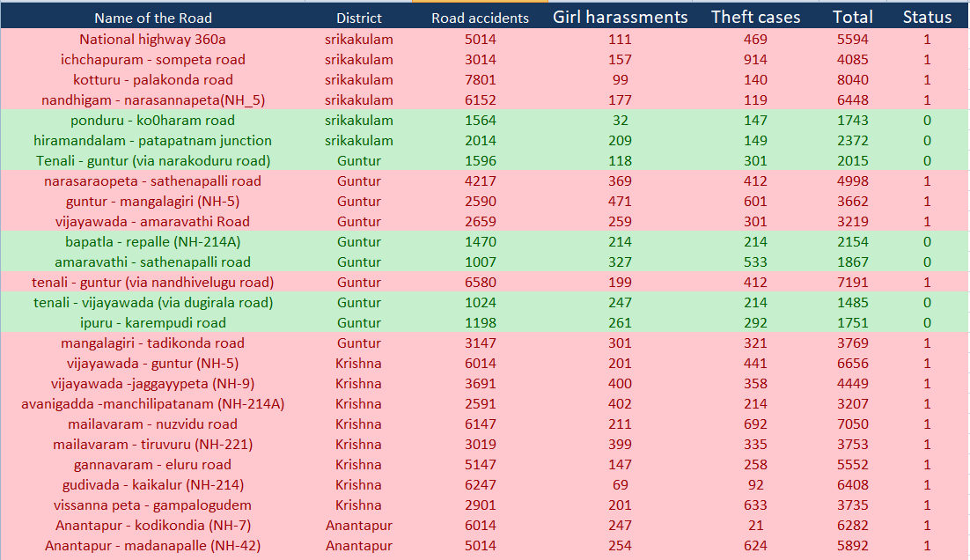
Sample Dataset

Slide 8
Continued…
Here we included the attributes such as, Name of the Road, District, Road Accidents, Girl Harassments, Theft Cases, Total No of Accidents, Status of the road.
0 - DANGEROUS
1 - NON DANGEROUS
We took 3000 (accidents) as a cut off limit to segregate the dangerous and non dangerous roads list. That means, the roads where the total number of accidents are greater than 3000, then they will be categorized as Dangerous and the rest as non- Dangerous.

Slide 9

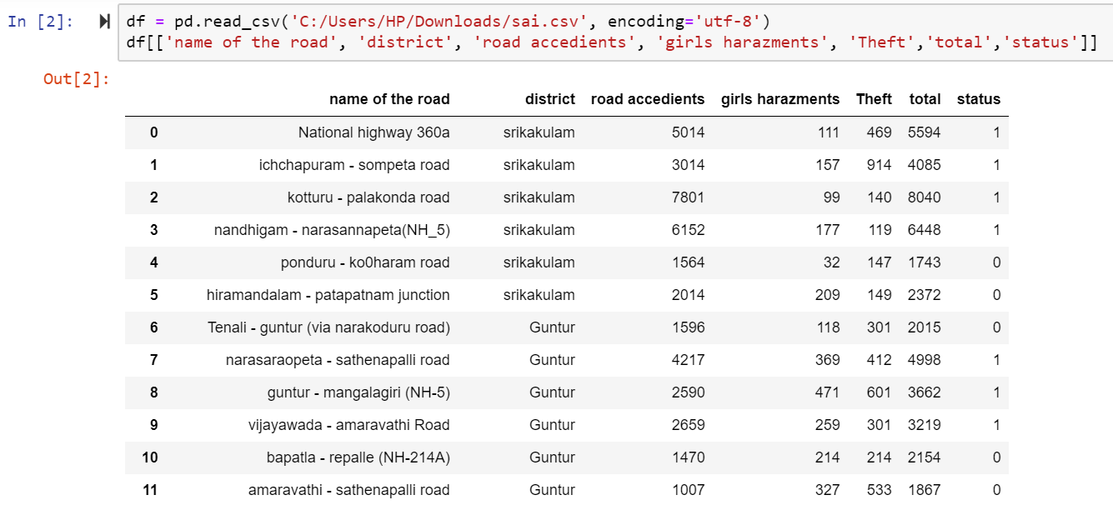
Results
Step-1: Installing Library
Step-2: Loading Data set

Slide 10
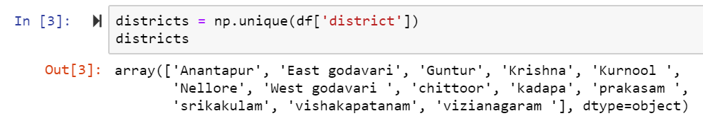
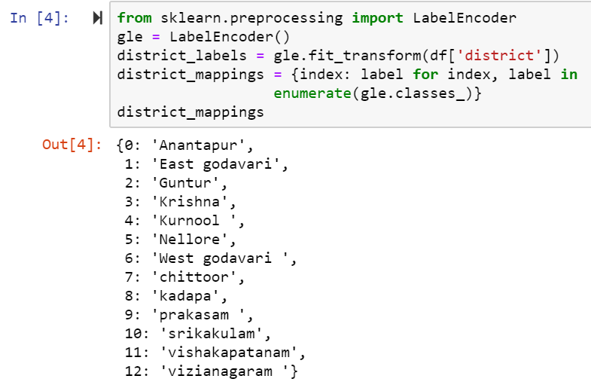
Results
Step-3: Identifying no of Districts
Step 4: District Mappings

Slide 11
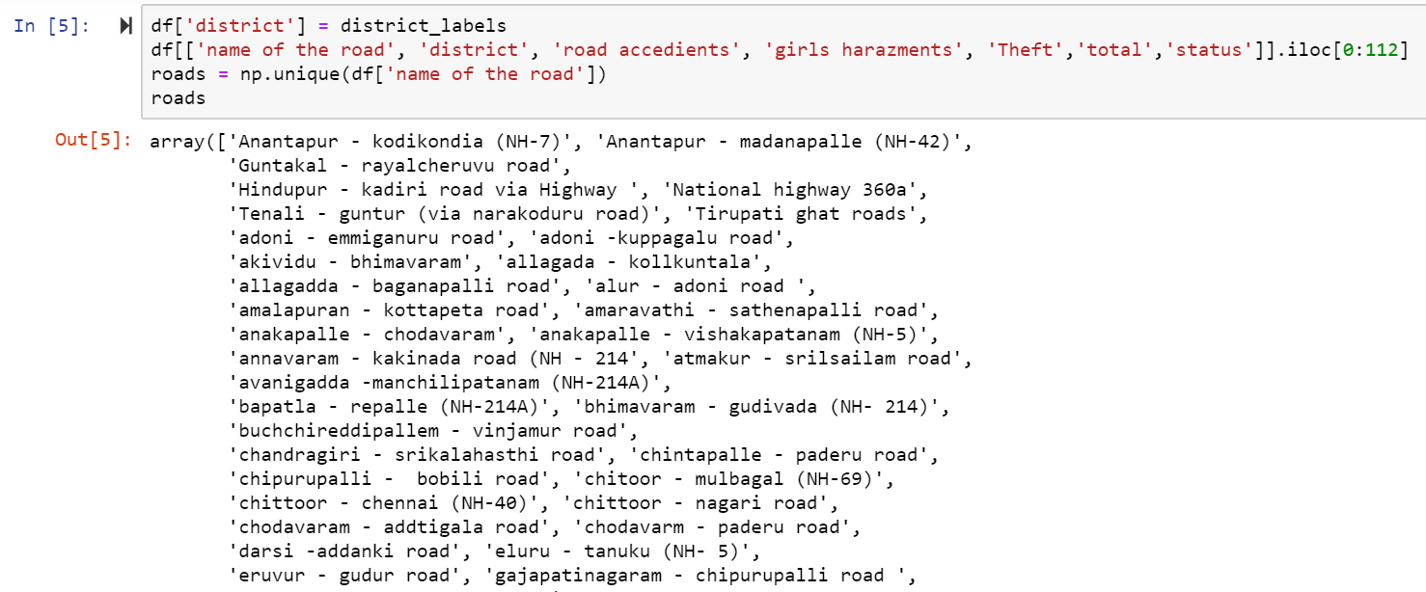
Results
Step-5: Identifying no of Roads

Slide 12
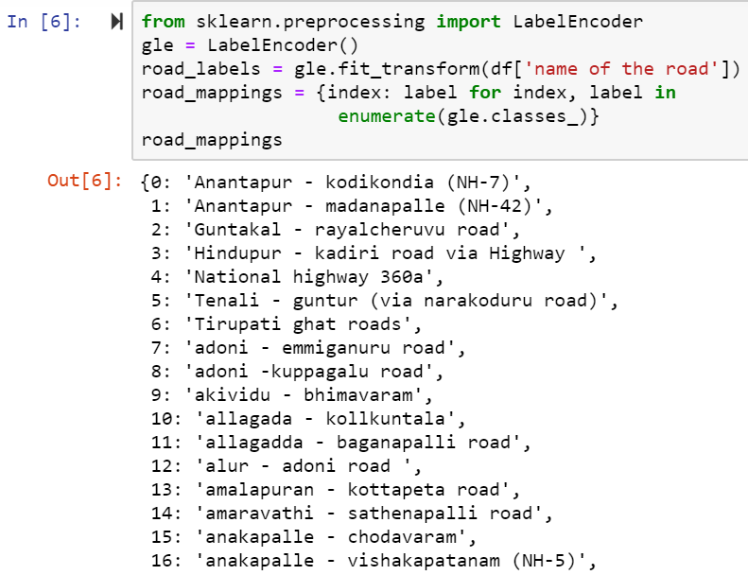
Results
Step-6: Road Mappings

Slide 13
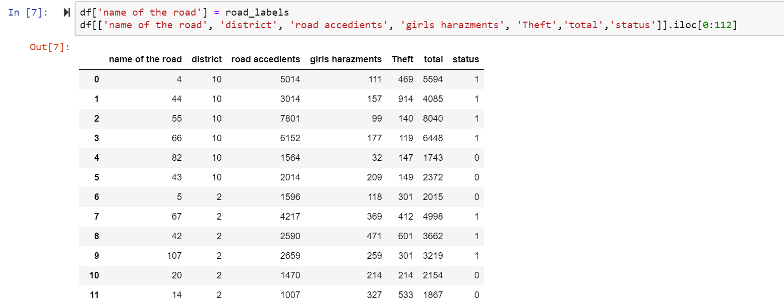
Results
Step-7: Nominal to Numeric Conversion

Slide 14
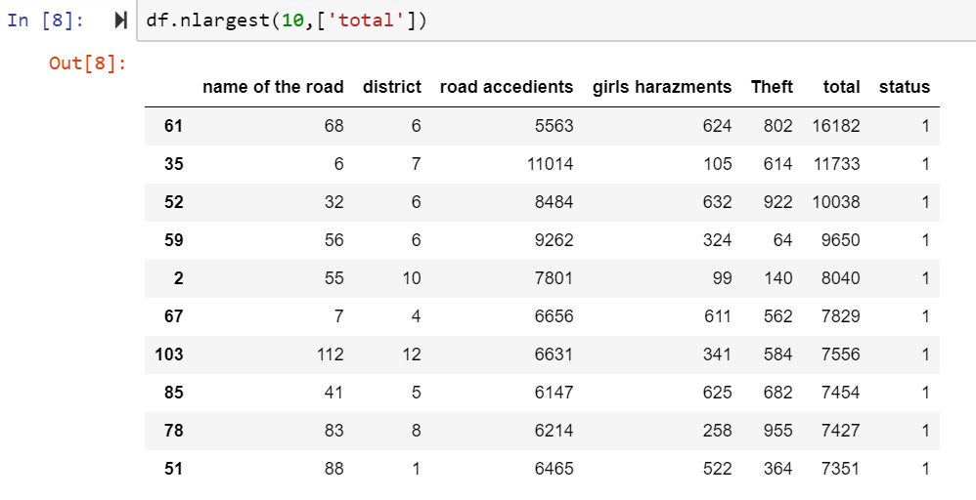
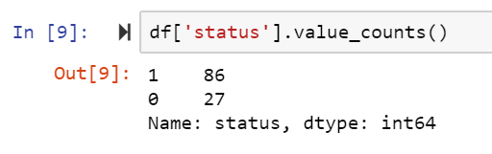
Results
Step-8: Arranging the rows in Descending Order i.e., identifying the Road
with Major Accidents.
Step-9: Identifying the no of Dangerous and Non-Dangerous Roads in the Data set

Slide 15
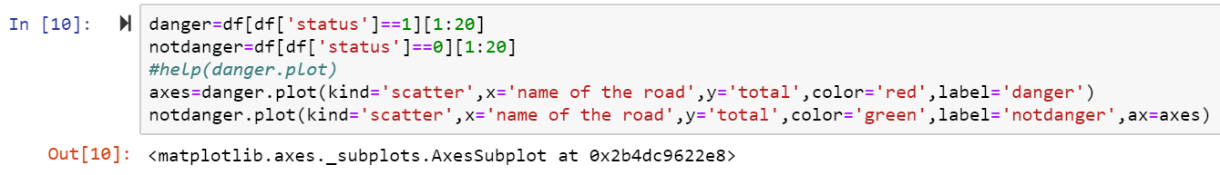
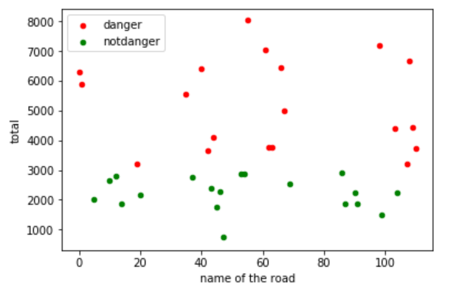
Results
Step-10: Classifying Dangerous & Non-dangerous roads by plotting them in a
graph

Slide 16
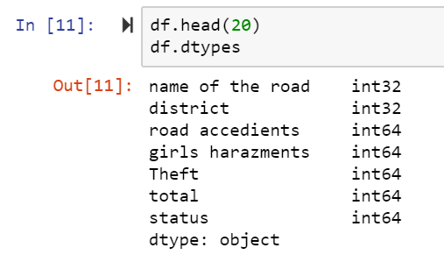
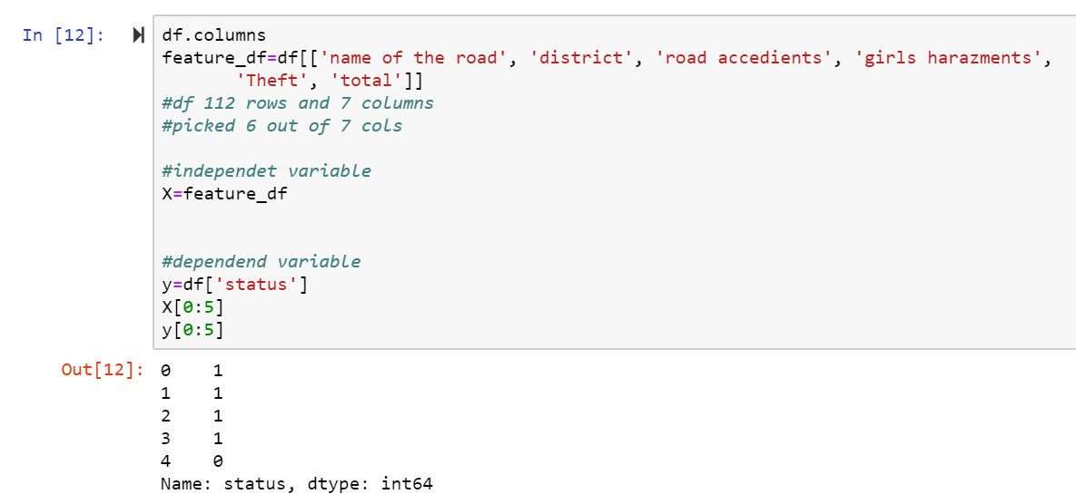
Results
Step-11: Displaying the type of each attribute
Step-12: Segregation of Dependent & Independent Variables

Slide 17
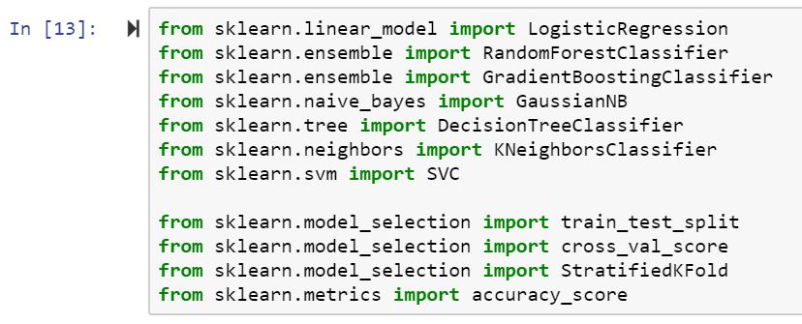
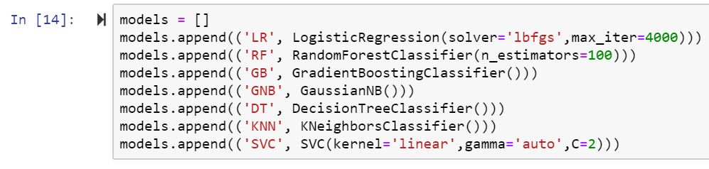
Results
Step-13: Importing different types of classifiers
Step-14: Different Classifiers/models are appending into a single Model List

Slide 18
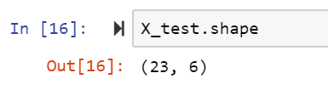
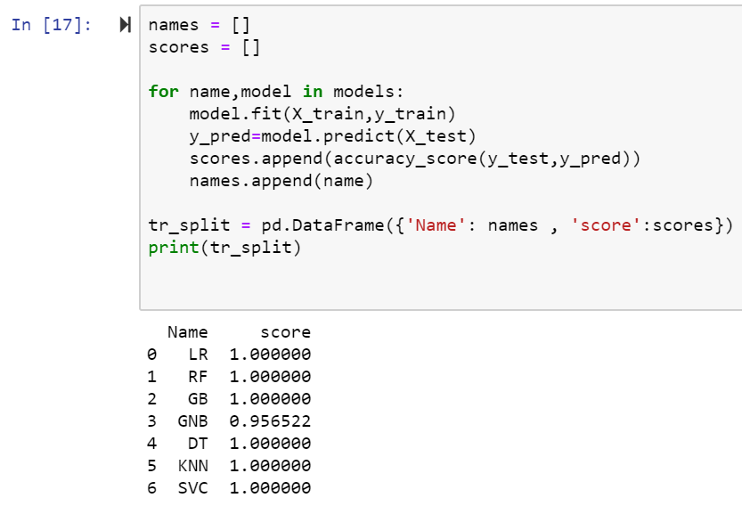
Results
Step-15: Training & Testing Phase
Step-16: Saying that the model is taking 23 Roads having 6 columns for
Training
Step-17: Displaying various classifiers and their respective accuracy score

Slide 19
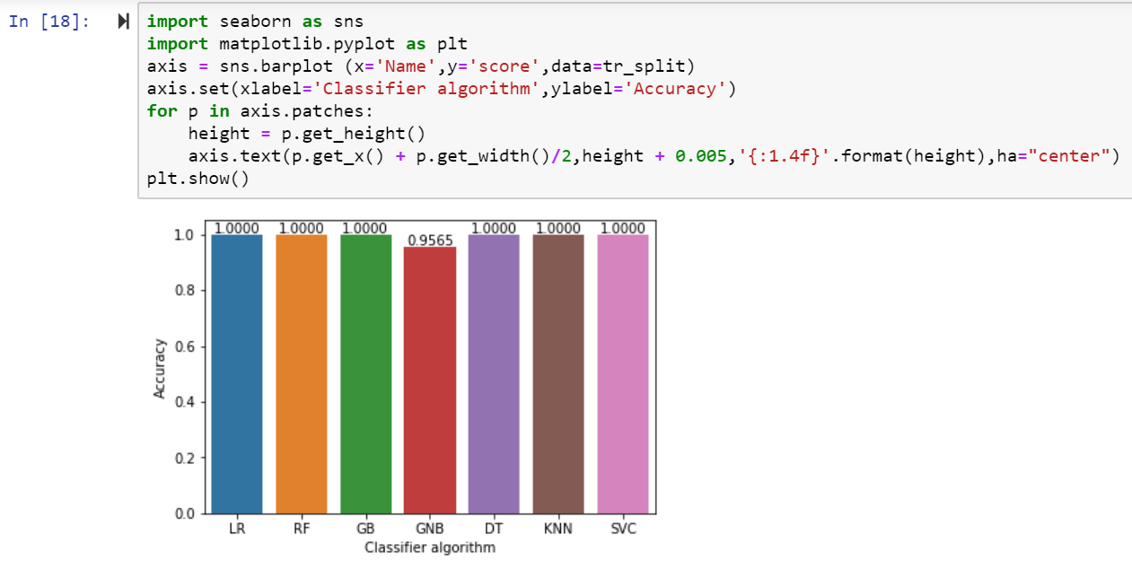
Results
Step-18: Visualizing the accuracy of various classifiers through Classifier
Algorithm

Slide 20
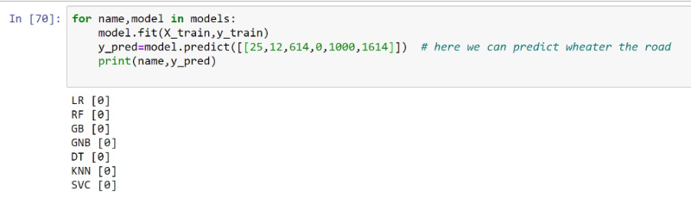
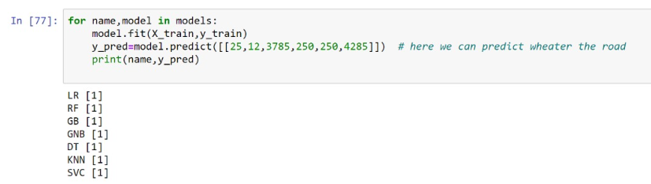
Results
Step-19: Checking for classifiers whether they are predicting for the given
input as dangerous or non dangerous aptly
Where we can observe here, that all classifiers predicts the road registered with 1614 cases, as non dangerous road & the road registered with 4285 cases as Dangerous road respectively.

Slide 21
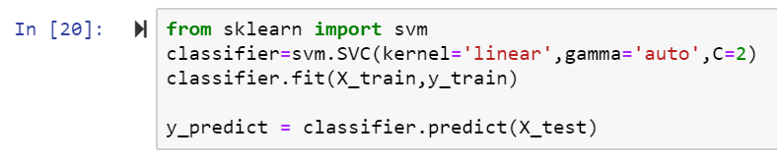
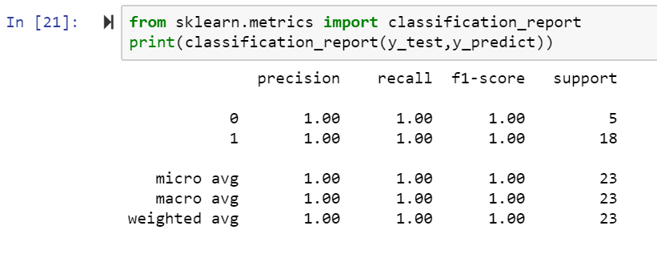
Results
Step-20: Applying SVM Classification Technique and predicting the result
Step-21: Final Classification Report for SVM method

Slide 22
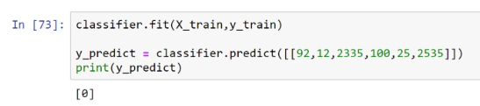
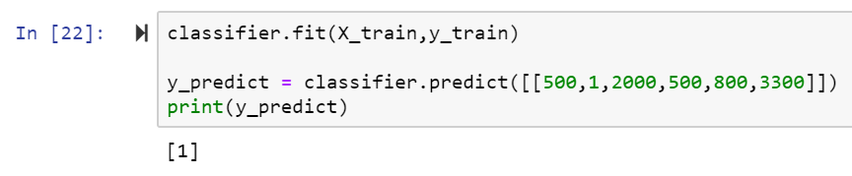
Results
Step-22: Check for Prediction
As we can see in the above step, the no of accidents registered at a particular road is given as 2535, and the classifier predicts it as a non Dangerous road by generating the status value as “0” which is accurate.
As we can see in the above step, the no of accidents registered at a particular road is given as 3300, and the classifier predicts it as a Dangerous road by generating the status value as “1” which is accurate.

Slide 23
Future Scope
We wish to add more attributes to it and to have more apt results.
Hence, after testing on a set of attributes, we hope to extend the scope of the project by joining the attributes like state of the country, no of curves/ U-turns, wild animal attacks at those particular roads across the country.
These parameters may improve the accuracy. Unsupervised clustering to label data for classifiers will also improve accuracy, instead of using fixed intervals for the same.

Slide 24
Conclusion
We conclude that the application of data mining algorithms, predicts about the Dangerous Roads as Dangerous and non-Dangerous as Not dangerous by using the data of the previous decade.
So that, when the data reached to the Government, it can take all those Road safety measures at the respective Dangerous roads and some of them might be the Dividers, speed limit boards, Wild animal prone areas, Road under construction work, zebra crossings etc.

Slide 25
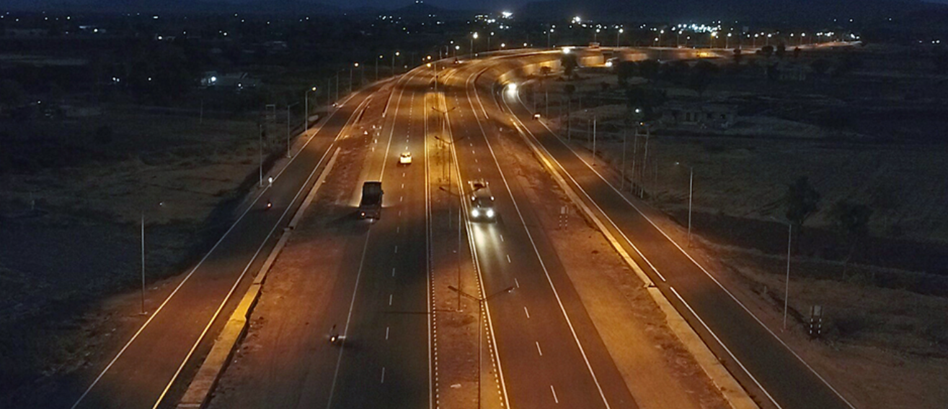
by 171fa04423 171fa04427 171fa04488

Slide 26


